Slide 1
Instagram Performance Analytics for Sugar Cosmetics

Slide 2
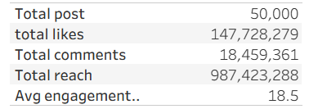
Task 1 : Overview KPIs – Brand’s Instagram Summary
The brand has a large-scale Instagram presence with 50,000 posts and nearly 1 billion total reach, showing strong awareness and long-term content strategy.
Engagement is highly active with 147M likes and 18.4M comments, indicating a very engaged and interactive audience, not just passive viewers.
Each post performs strongly on average, generating around 2.9K likes and 369 comments, showing consistent content efficiency even at high volume.
The average engagement rate (~18.5%) is extremely high compared to industry standards,

Slide 3
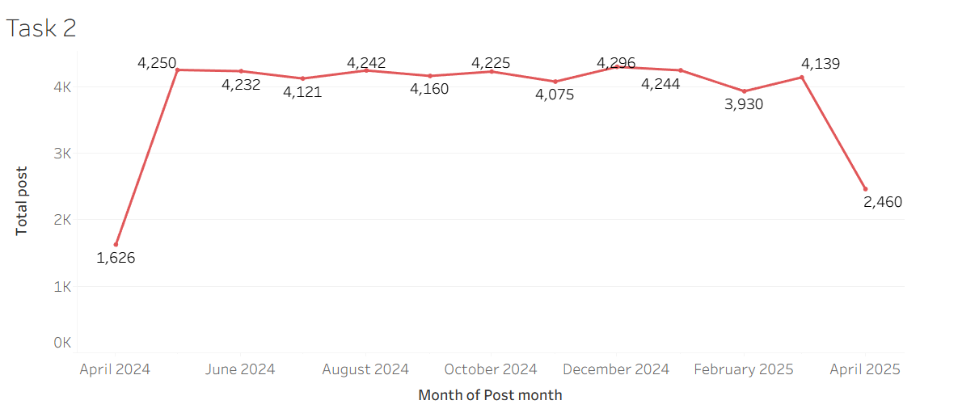
Task 2: Monthly Posting Trend
Stable output: ~4,000–4,300 posts/month (May 2024–Mar 2025)
* Drops in April: Likely partial data, not performance decline
* Minor dip: Feb 2025 lower due to shorter month
* High scale: ~135 posts/day shows automated/templated content system
* Overall: Very consistent high-volume content strategy

Slide 4
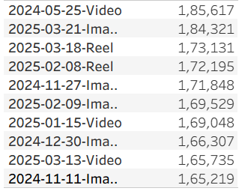
Task 3: Top 10 Posts by Likes
Top 10 posts indicate high audience interest content
Helps identify:
content type (Reels, Images, etc.)
Best campaign type
Viral posts
High likes usually = strong reach + engagement synergy

Slide 5
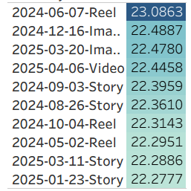
Task 4: Top 10 Posts by Engagement Rate
Top posts by engagement rate show true content quality
High likes ≠ high engagement
Engagement rate reveals:
audience interaction strength
content relevance
viral potential

Slide 6
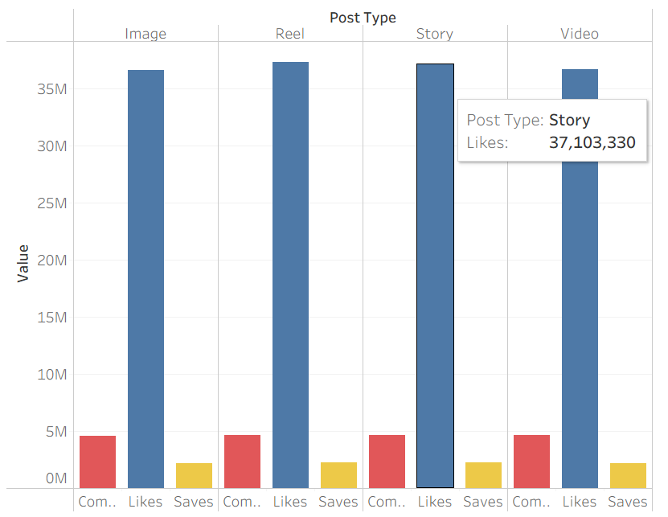
Task 5: Post Type Performance Comparison
Show average likes, comments, saves for each type.

Slide 7
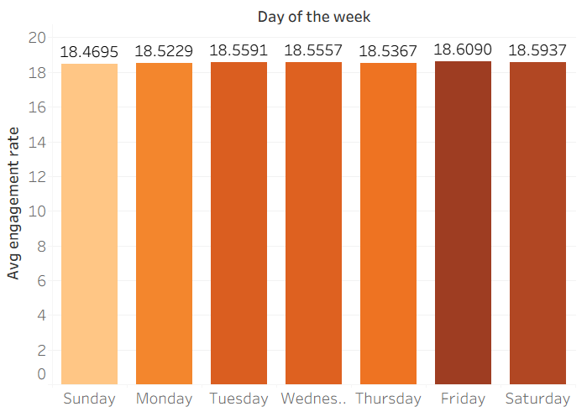
Task 6: Day of Week Analysis
Engagement is almost same across all days
* Friday & Saturday slightly highest
* Sunday lowest but difference is minimal
* Overall: no strong weekday impact

Slide 8
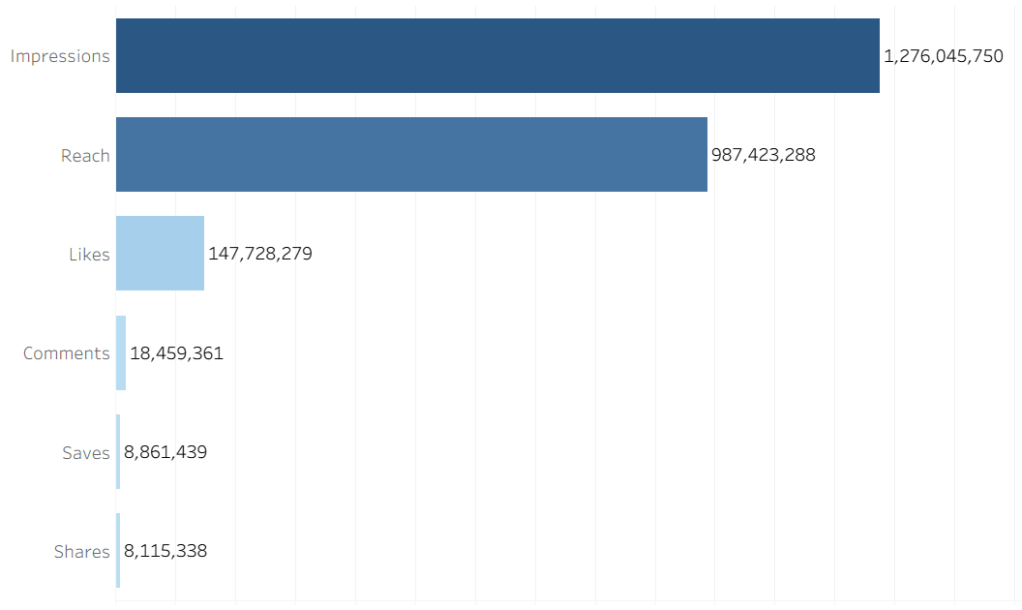
Task 7: Engagement Funnel
Funnel performance with 1.27B impressions and 987.4M reach, proving the campaign successfully gained massive visibility.
Strong Audience Relevancy: A high 77.3% of impressions converted into actual unique reach, meaning ad targeting was highly accurate.
The Engagement Gap: Passive interest is decent (147.7M likes), but deep engagement drops off drastically with only 1.8% of reached users commenting (18.4M).
Low Conversion Intent: High-value advocacy actions are critically low, as both saves (8.8M) and shares (8.1M) account for under 1% of total reach.

Slide 9
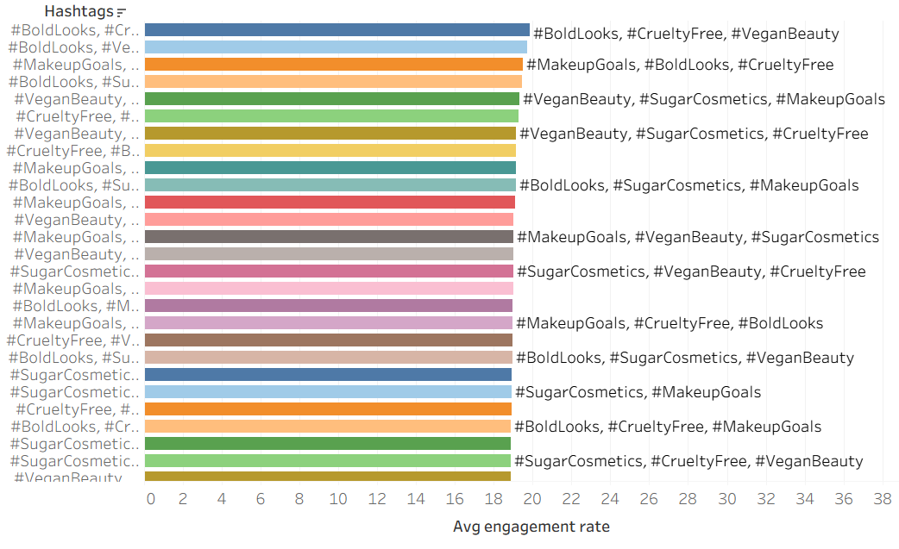
Task 8: Hashtag Analysis

Slide 10
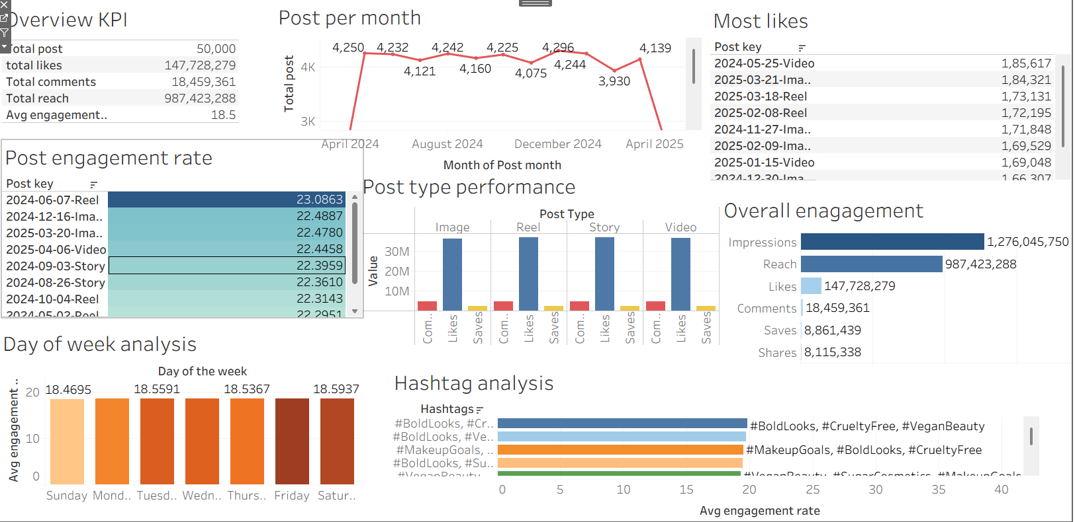
Task 9: Final Dashboard – Instagram Insights Report

Slide 11
Task 10: Strategic Recommendation
Key insights :
Strong brand visibility with ~987M reach and consistent posting (~4K/month)
Engagement rate (~18–22%) shows healthy audience interaction
Engagement is stable across days with slight mid-week advantage.
My recommendation:
Maintain consistent posting frequency (avoid fluctuations)
Prioritize Wed–Fri for higher engagement potential
Focus more on Reels + Product Launch + Influencer content
Need to focus more on Influencer marketing.
Seasonal giveaway campaigns tied to product launches.
Seasonal content posting.
Making blog or 7 days transformation series.

Slide 12
THANK YOU

